Slide 1
Model View Controller

Slide 2
Goals
To learn about the Model-View-Controller design pattern
Explain the significance of division of responsibility for modularity
Evaluate source code examples illustrating model view controller

Slide 3
The Concept of MVC
A software architectural pattern
Divides an application into the three interconnected parts.
Done to separate internal representations of information from the ways information is presented to, and accepted from, the user
Decouples these major components, allowing for efficient code reuse and parallel development.
Traditionally used for desktop graphical user interfaces (GUIs)
Now used for web applications and mobile apps
Programming languages like Java, C#, Ruby, PHP and others have MVC frameworks
Some Java Web Frameworks (including MVC)

Slide 4
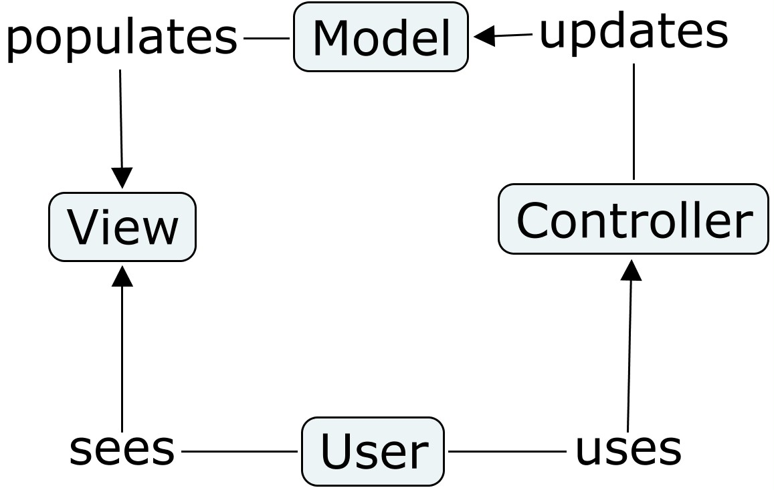
MVC Organization

Slide 5
Components
The model is the central component of the pattern. It expresses the application's behavior in terms of the programming domain, independent of the user interface. It directly manages the data, logic and rules of the application.
A view can be any output representation of information, such as a chart or a diagram. Multiple views of the same information are possible, such as a bar chart for management and a tabular view for accountants.
The third part or section, the controller, accepts input and converts it to commands for the model or view.

Slide 6
Interactions
The Model
  Responsible for managing the data of the application.
  Responds to the request from the view
  responds to instructions from the controller to update itself.
The View:
  presentation of data in a particular format, triggered by a controller's decision to present the data.
  script-based templating systems like JSP, ASP, PHP and very easy to integrate with AJAX technology.
The controller
  responsible for responding to the user input and perform interactions on the data model objects.
  receives and validates the input and then performs the business operation that modifies the state of the data model.

Slide 7
Goals of MVC
Simultaneous development
  MVC decouples the various components of an application
  developers are able to work in parallel on different components without impacting or blocking one another.
  Example
    divide developers between the front-end and the back-end.
    The back-end developers can design
      the structure of the data
      how the user interacts with it without requiring the user interface to be completed.
    The front-end developers are able to design and test the interface prior to the data structure being available.
Code reuse
  Components are independent of one another,
  Independence facilitates reuse
  The same (or similar) view for one application can be refactored for another application with different data because the view is simply handling how the data is being displayed to the user.

Slide 8
Advantages
Simultaneous development – Multiple developers can work simultaneously on the model, controller and views.
High Cohesion– MVC enables logical grouping of related actions on a controller together. The views for a specific model are also grouped together.
Low Coupling– The very nature of the MVC framework is such that there is low coupling among models, views or controllers
Ease of modification – Because of the separation of responsibilities, future development or modification is easier
Multiple views for a model – Models can have multiple views

Slide 9
Disadvantages
Code navigability – The framework navigation can be complex because it introduces new layers of abstraction and requires users to adapt to the decomposition criteria of MVC.
Multi-artifact consistency – Decomposing a feature into three artifacts causes scattering. Thus, requiring developers to maintain the consistency of multiple representations at once.
Pronounced learning curve – Knowledge on multiple technologies becomes the norm. Developers using MVC need to be skilled in multiple technologies.

Slide 10
Java Examples
  Example at Oracle
  TutorialsPoint example we will analyze
  Other Examples:

Slide 11
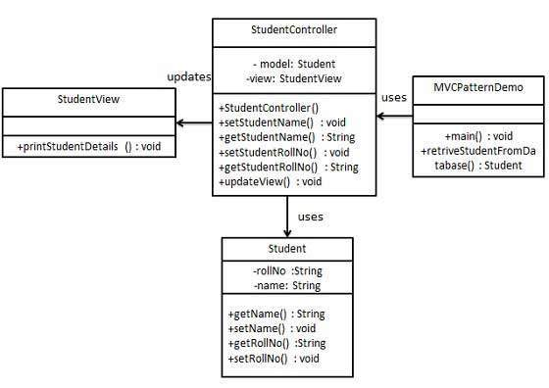

Slide 12
TutorialsPoint Model
public class Student {
private String rollNo;
private String name;
public String getRollNo() {
return rollNo;
}
public void setRollNo(String rollNo) {
this.rollNo = rollNo;
}
public String getName() {
return name;
}
public void setName(String name) {
this.name = name;
}
}

Slide 13
TutorialsPoint View
public class StudentView {
public void printStudentDetails(String studentName, String studentRollNo){
System.out.println("Student: ");
System.out.println("Name: " + studentName);
System.out.println("Roll No: " + studentRollNo);
}
}

Slide 14
TutorialsPoint Controller
public class StudentController {
private Student model;
private StudentView view;
public StudentController(Student model, StudentView view){
this.model = model;
this.view = view;
}
public void setStudentName(String name){
model.setName(name);
}
public String getStudentName(){
return model.getName();
}

Slide 15
TutorialsPoint Controller (cont)
public void setStudentRollNo(String rollNo){
model.setRollNo(rollNo);
}
public String getStudentRollNo(){
return model.getRollNo();
}
public void updateView(){
view.printStudentDetails(model.getName(), model.getRollNo());
}
}

Slide 16
TutorialsPoint Driver
public class MVCPatternDemo {
public static void main(String[] args) {
Student model = retriveStudentFromDatabase();
StudentView view = new StudentView();
StudentController controller = new
StudentController(model, view);
controller.updateView();
controller.setStudentName("John");
controller.updateView();
}
. . .

Slide 17
TutorialsPoint Driver (cont)
private static Student retriveStudentFromDatabase(){
Student student = new Student();
student.setName("Robert");
student.setRollNo("10");
return student;
}
}

Slide 18
Summary
MVC is a high-level, architectural design pattern
Affords parallel development by separation of responsibility (a key idea in effective factoring of programs)
Affords component reuse
Well adapted to web applications
A learning curve is associated with MVC frameworks

